Slide 1
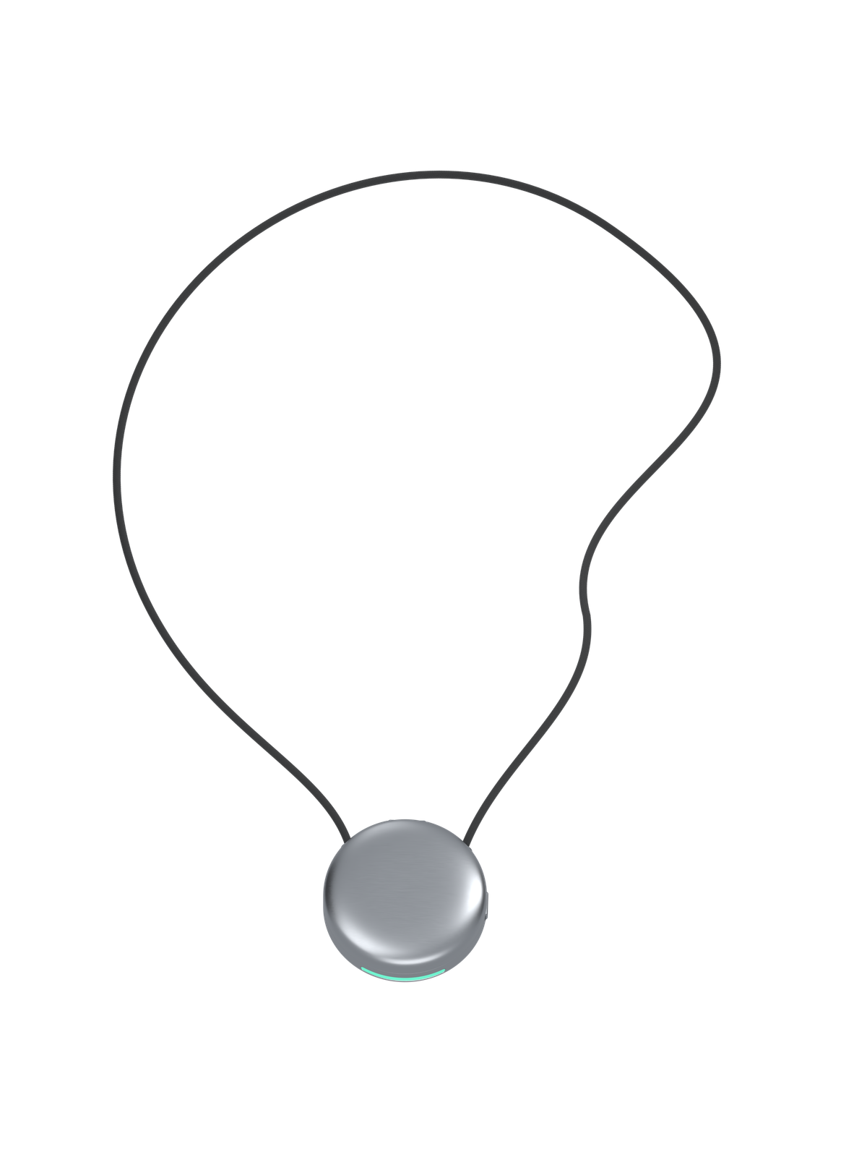
aspera
Nutrition, in the
flow of life
A voice nutrition pendant
with meal review in MetricSync
Aura Technologies LLC · In development
01
Notes:
Aspera moves the first step of meal logging to a pendant. Press and hold, describe a meal, release, then review a suggestion in MetricSync. The central hypothesis is that accessible capture can support a more consistent food log.
Image: user-supplied Images/05 Flowing suspended necklace.png.
Product basis: Aspera README.md; content/aspera-brand-copy.json; public/aspera-demos.js; project reviewed September 5, 2026. Product architecture and commercial plans described as proposals. The website contains illustrative interactions. The founder reports a 3D-printed enclosure, battery and Seeed Studio hardware with partially working audio capture and Bluetooth transfer to an app. No independent hardware demonstration or reliability measurements were available. Automated interpretation and the complete workflow remain development goals. Aspera is a project of Aura Technologies LLC; contact@aura-technologies.co. No measured product performance, sales, or partnerships are asserted.

Slide 2
aspera
Food logging is difficult to sustain
49.3%
The product question
Can easier capture
help people keep
a usable meal log?
Average food logging adherence
Days with at least five foods logged,
months 4–11 of weight loss maintenance
Study of 72 adults. This finding supports the problem, not Aspera’s effectiveness.
02
Notes:
The study reports food logging adherence of 49.34% during phase II. Participants were 72 adults in a behavioral weight loss program. A valid dietary logging day required at least five foods recorded; phase II observations covered months 4–11. Adherence is the percentage of valid days, not a consumer churn or market-sizing measure. This study does not test a pendant or establish that lower capture friction solves disengagement.
Crane N, Hagerman C, Horgan O, Butryn M. Patterns and Predictors of Engagement With Digital Self-Monitoring During the Maintenance Phase of a Behavioral Weight Loss Program. JMIR mHealth and uHealth 2023;11:e45057. https://mhealth.jmir.org/2023/1/e45057/
Product basis: Aspera README.md; content/aspera-brand-copy.json; public/aspera-demos.js; project reviewed September 5, 2026. Product architecture and commercial plans described as proposals. The website contains illustrative interactions. The founder reports a 3D-printed enclosure, battery and Seeed Studio hardware with partially working audio capture and Bluetooth transfer to an app. No independent hardware demonstration or reliability measurements were available. Automated interpretation and the complete workflow remain development goals. Aspera is a project of Aura Technologies LLC; contact@aura-technologies.co. No measured product performance, sales, or partnerships are asserted.

Slide 3
aspera
The intended meal logging flow
“Two chapatis, a bowl of dal,
and a glass of milk.”
01
02
03
04
Hold
Speak
Release
Review
Start a recording.
Describe food and portions.
Save the recording.
Confirm in MetricSync.
03
Notes:
This is the intended user journey described on the website. Saving audio and confirming a nutrition entry are separate actions. Natural descriptions still need enough information to identify foods and portions.
Product basis: Aspera README.md; content/aspera-brand-copy.json; public/aspera-demos.js; project reviewed September 5, 2026. Product architecture and commercial plans described as proposals. The website contains illustrative interactions. The founder reports a 3D-printed enclosure, battery and Seeed Studio hardware with partially working audio capture and Bluetooth transfer to an app. No independent hardware demonstration or reliability measurements were available. Automated interpretation and the complete workflow remain development goals. Aspera is a project of Aura Technologies LLC; contact@aura-technologies.co. No measured product performance, sales, or partnerships are asserted.

Slide 4
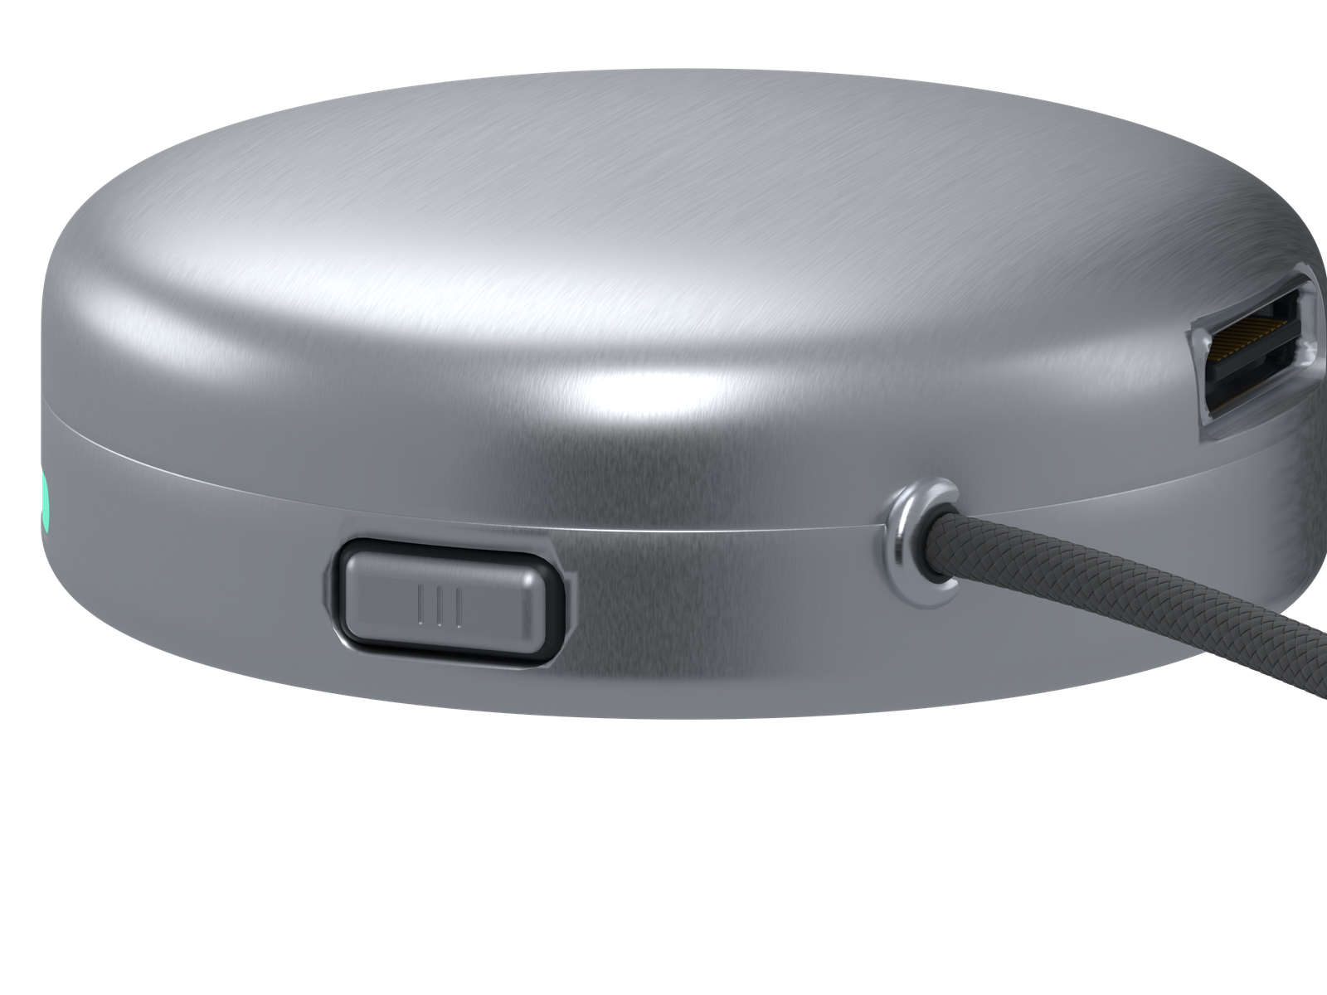
aspera
A wearable first step
Intended capture control
Hold to record, release to save.
A behavior to test in daily use.
A place in daily life
A pendant and charging dock create
a routine to test with real wearers.
04
Notes:
The render shows the intended industrial design. The project has no verified battery, weight, dimensions, acoustic, durability, or manufacturing results. Wearability and charging adherence are validation priorities.
Image: user-supplied Images/02 Talk button and brushed shoulder.png.
Product basis: Aspera README.md; content/aspera-brand-copy.json; public/aspera-demos.js; project reviewed September 5, 2026. Product architecture and commercial plans described as proposals. The website contains illustrative interactions. The founder reports a 3D-printed enclosure, battery and Seeed Studio hardware with partially working audio capture and Bluetooth transfer to an app. No independent hardware demonstration or reliability measurements were available. Automated interpretation and the complete workflow remain development goals. Aspera is a project of Aura Technologies LLC; contact@aura-technologies.co. No measured product performance, sales, or partnerships are asserted.

Slide 5
aspera
The user has the final say
“A bowl of dal” needs context before it becomes a useful estimate.
Detail | Suggested interpretation | User review
Food | Dal or lentil dish | Choose the recipe or closest match
Amount | One bowl | Confirm the portion or weight
Extras | Oil is unspecified | Add the amount if known
Planned: only confirmed entries join the log. Illustrative review, not measured nutrition.
05
Notes:
Food names alone cannot establish the contents of a meal. A proposed review step preserves the transcript, shows a food match and makes unresolved amounts visible. The user can correct or reject suggestions. The example contains no measured nutrition values.
Product basis: Aspera README.md; content/aspera-brand-copy.json; public/aspera-demos.js; project reviewed September 5, 2026. Product architecture and commercial plans described as proposals. The website contains illustrative interactions. The founder reports a 3D-printed enclosure, battery and Seeed Studio hardware with partially working audio capture and Bluetooth transfer to an app. No independent hardware demonstration or reliability measurements were available. Automated interpretation and the complete workflow remain development goals. Aspera is a project of Aura Technologies LLC; contact@aura-technologies.co. No measured product performance, sales, or partnerships are asserted.

Slide 6
aspera
Inside the proposed product
Pendant
Record the spoken meal and retain it locally.
Phone
Transfer saved audio when Bluetooth reconnects.
Processing
Transcribe speech, identify foods and retrieve nutrition references.
MetricSync
Resolve unclear portions, confirm the meal and update the log.
Offline capture is planned. Transcription and food lookup may require internet access.
06
Notes:
This is a proposed architecture, not a description of implemented firmware or production services. The website specifies local recording and planned Bluetooth transfer. The white paper proposes acknowledgements, durable queues and explicit confirmation semantics. Model vendors and device components remain open.
Bluetooth SIG, The Bluetooth Low Energy primer. https://www.bluetooth.com/bluetooth-le-primer/
USDA FoodData Central API Guide. https://fdc.nal.usda.gov/api-guide/
Product basis: Aspera README.md; content/aspera-brand-copy.json; public/aspera-demos.js; project reviewed September 5, 2026. Product architecture and commercial plans described as proposals. The website contains illustrative interactions. The founder reports a 3D-printed enclosure, battery and Seeed Studio hardware with partially working audio capture and Bluetooth transfer to an app. No independent hardware demonstration or reliability measurements were available. Automated interpretation and the complete workflow remain development goals. Aspera is a project of Aura Technologies LLC; contact@aura-technologies.co. No measured product performance, sales, or partnerships are asserted.

Slide 7
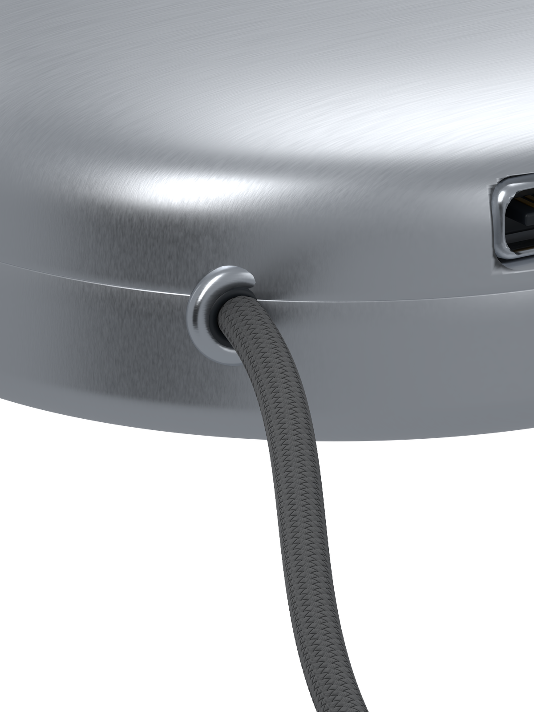
aspera
A focused first customer
Adults who already want to log meals,
but lose the habit during busy days.
First cohort hypothesis
Recruit existing food trackers through
fitness communities and independent coaches.
Test comfort, review effort and repeat use.
07
Notes:
The proposed initial segment has existing motivation to log meals and can compare the pendant against their current process. Community and coach outreach are proposed acquisition channels, not secured partnerships. A consumer wellness pilot should evaluate logging behavior, not promise medical outcomes.
Image: user-supplied Images/03 Textile to aluminum transition.png.
Product basis: Aspera README.md; content/aspera-brand-copy.json; public/aspera-demos.js; project reviewed September 5, 2026. Product architecture and commercial plans described as proposals. The website contains illustrative interactions. The founder reports a 3D-printed enclosure, battery and Seeed Studio hardware with partially working audio capture and Bluetooth transfer to an app. No independent hardware demonstration or reliability measurements were available. Automated interpretation and the complete workflow remain development goals. Aspera is a project of Aura Technologies LLC; contact@aura-technologies.co. No measured product performance, sales, or partnerships are asserted.

Slide 8
aspera
The competition already includes voice
Approach | Capture moment | Implication for Aspera
Phone food logging | Search or voice inside an app | No added device to carry or charge
MyFitnessPal Voice Log | Speak in the phone app, then review | Voice alone is not a defensible advantage
Aspera concept | Press a wearable, review on the phone | Must prove a benefit from wearable capture
MyFitnessPal documents online voice logging and review before saving. Aspera features are planned.
08
Notes:
MyFitnessPal offers Voice Logging to eligible Premium users. The documented flow begins in the phone app, requires a stable internet or cellular connection, and allows changes before logging. Aspera’s proposed differentiation is wearable capture with deferred review and local recording. Its advantage remains untested. Generic phone logging refers to the category and is not a claim about every app.
MyFitnessPal, Voice Logging, updated August 5, 2025. https://support.myfitnesspal.com/hc/en-us/articles/30332897072269-Voice-Logging
Product basis: Aspera README.md; content/aspera-brand-copy.json; public/aspera-demos.js; project reviewed September 5, 2026. Product architecture and commercial plans described as proposals. The website contains illustrative interactions. The founder reports a 3D-printed enclosure, battery and Seeed Studio hardware with partially working audio capture and Bluetooth transfer to an app. No independent hardware demonstration or reliability measurements were available. Automated interpretation and the complete workflow remain development goals. Aspera is a project of Aura Technologies LLC; contact@aura-technologies.co. No measured product performance, sales, or partnerships are asserted.

Slide 9
aspera
Hardware and software economics
A model to validate
Pendant purchase
MetricSync service
Revenue must cover the device, fulfillment,
returns and warranty support.
Test an optional subscription against
ongoing processing and support costs.
Commercial gate
Willingness to pay and retained use must justify both the device and its service.
09
Notes:
Proposed business model, not announced pricing. No price, revenue, margin, manufacturing quotation or customer acquisition cost is established. Device contribution equals net device revenue less landed cost, fulfillment, returns and warranty. Service contribution equals subscription revenue less payment fees, variable inference, storage and support. Financing should follow measured demand and credible manufacturing costs.
Product basis: Aspera README.md; content/aspera-brand-copy.json; public/aspera-demos.js; project reviewed September 5, 2026. Product architecture and commercial plans described as proposals. The website contains illustrative interactions. The founder reports a 3D-printed enclosure, battery and Seeed Studio hardware with partially working audio capture and Bluetooth transfer to an app. No independent hardware demonstration or reliability measurements were available. Automated interpretation and the complete workflow remain development goals. Aspera is a project of Aura Technologies LLC; contact@aura-technologies.co. No measured product performance, sales, or partnerships are asserted.

Slide 10
aspera
The pilot must prove the complete habit
Capture is only the beginning.
Success includes a meal the user actually confirms.
Use
Confirmed meals per active day
Effort
Capture time plus review time
Reliability
Lost recordings and duplicate entries
Trust
Food and portion corrections
10
Notes:
Proposed pilot design: establish each participant’s baseline, then compare pendant capture with phone-only voice using a counterbalanced crossover. Keep the processing and review experience comparable. Predefine a meaningful improvement threshold and analyze confirmed entries, retention, burden, audio transfer reliability and nutrition error. Do not count recordings alone as successful logs. Include noisy settings, varied accents and cuisines.
Product basis: Aspera README.md; content/aspera-brand-copy.json; public/aspera-demos.js; project reviewed September 5, 2026. Product architecture and commercial plans described as proposals. The website contains illustrative interactions. The founder reports a 3D-printed enclosure, battery and Seeed Studio hardware with partially working audio capture and Bluetooth transfer to an app. No independent hardware demonstration or reliability measurements were available. Automated interpretation and the complete workflow remain development goals. Aspera is a project of Aura Technologies LLC; contact@aura-technologies.co. No measured product performance, sales, or partnerships are asserted.

Slide 11
aspera
Capital should unlock clear milestones
01
Reliable prototype
Reliable capture, reconnect and review
across the pendant and phone.
02
Comparative pilot
Evidence that the pendant improves
logging without adding review burden.
03
Production decision
Costed manufacturing, verified reliability
and demonstrated willingness to pay.
11
Notes:
This is a milestone-based funding and development proposal. It does not announce a financing round, budget, timeline or manufacturing commitment. Embedded systems, mobile engineering, nutrition data evaluation and product research are the required workstreams. The project does not provide founder biographies or a staffed team.
Product basis: Aspera README.md; content/aspera-brand-copy.json; public/aspera-demos.js; project reviewed September 5, 2026. Product architecture and commercial plans described as proposals. The website contains illustrative interactions. The founder reports a 3D-printed enclosure, battery and Seeed Studio hardware with partially working audio capture and Bluetooth transfer to an app. No independent hardware demonstration or reliability measurements were available. Automated interpretation and the complete workflow remain development goals. Aspera is a project of Aura Technologies LLC; contact@aura-technologies.co. No measured product performance, sales, or partnerships are asserted.

Slide 12
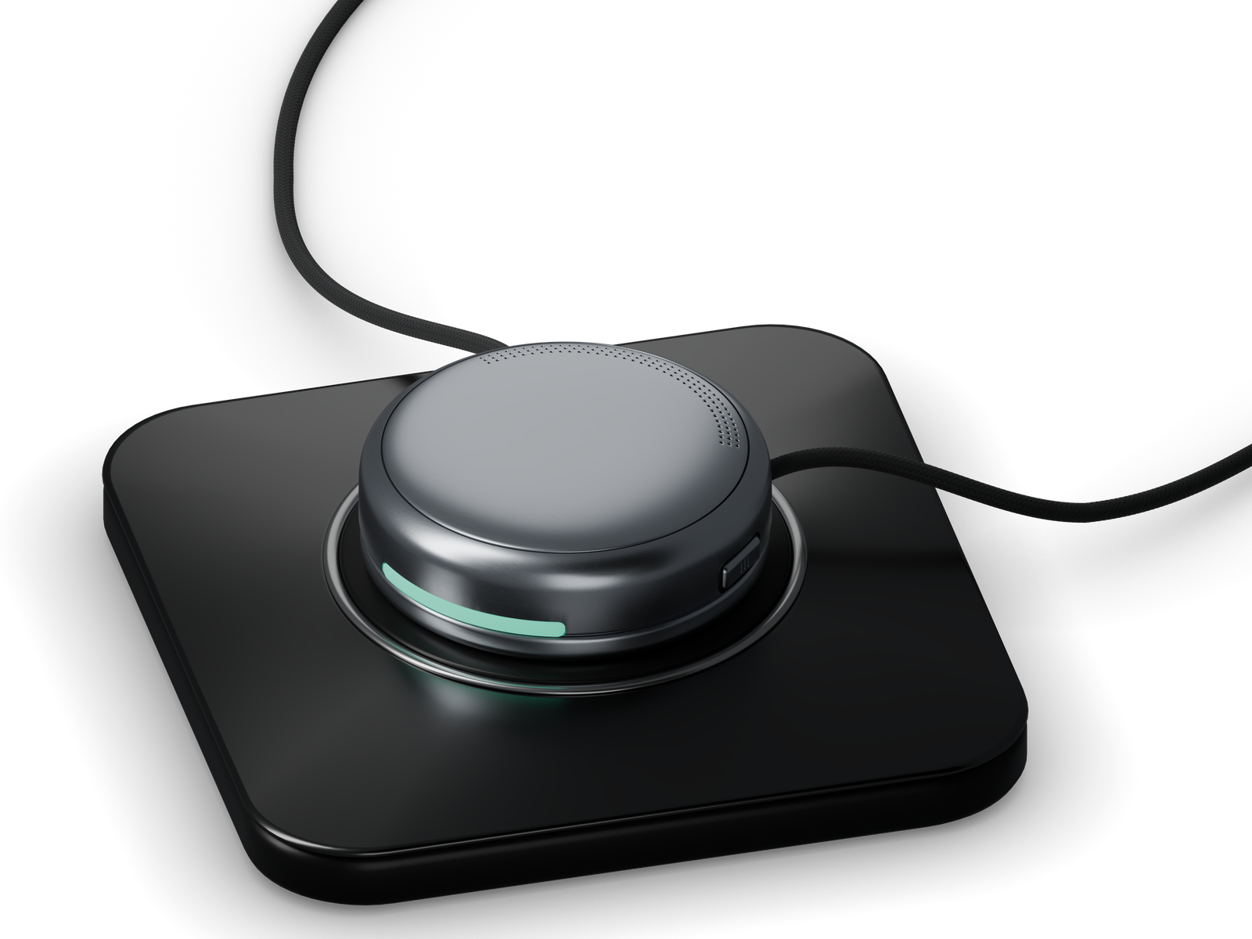
aspera
An early prototype, with work ahead
Founder-reported prototype
3D-printed enclosure + battery
Seeed hardware
Partial audio + Bluetooth transfer
Next evidence
Reliable capture, food processing
and a pilot against phone-only voice.
Intended design render
12
Notes:
The founder-reported prototype status is described on the slide; the adjacent image is an intended design render, not a prototype photograph. The exact board, app code and firmware were not supplied. The repository demonstrates simulated UI interactions, not device capture or production nutrition processing.
The repository contains an interactive concept website and supplied renders. The app preview uses deterministic example meals, timeouts and UI state changes. The repository does not demonstrate working device capture, Bluetooth transfer, transcription, nutritional inference or persistent production meal storage. This distinction is material to investor diligence.
Image: user-supplied Images/04 Premium pendant on dock.png.
Product basis: Aspera README.md; content/aspera-brand-copy.json; public/aspera-demos.js; project reviewed September 5, 2026. Product architecture and commercial plans described as proposals. The website contains illustrative interactions. The founder reports a 3D-printed enclosure, battery and Seeed Studio hardware with partially working audio capture and Bluetooth transfer to an app. No independent hardware demonstration or reliability measurements were available. Automated interpretation and the complete workflow remain development goals. Aspera is a project of Aura Technologies LLC; contact@aura-technologies.co. No measured product performance, sales, or partnerships are asserted.

Slide 13
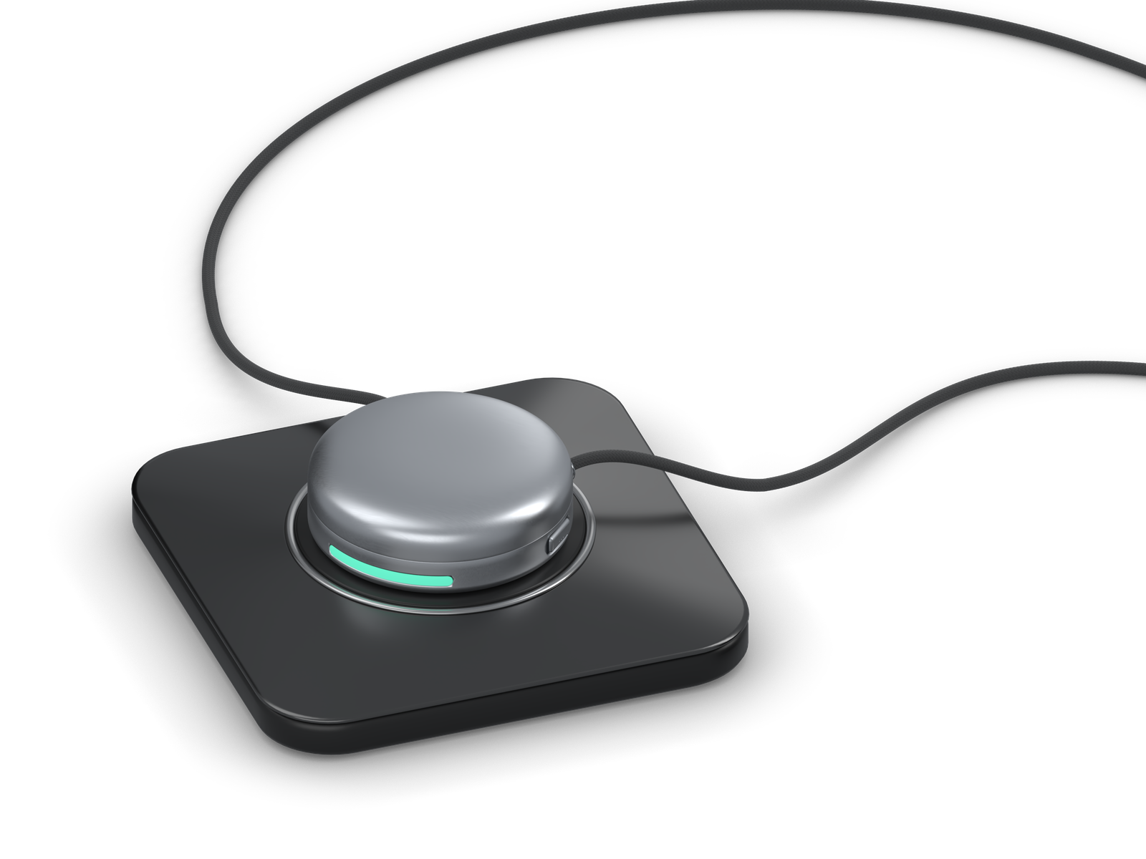
aspera
A nutrition pendant
for everyday meals
Build a reliable end-to-end prototype,
then run a focused user pilot.
Seeking early investors and product partners
to help test and build Aspera.
Aura Technologies LLC · contact@aura-technologies.co
13
Notes:
The invitation is to discuss development and validation support. No investment amount or terms are specified. Product remains in development.
Image: user-supplied Images/06 Dock and curved textile cord.png.
Product basis: Aspera README.md; content/aspera-brand-copy.json; public/aspera-demos.js; project reviewed September 5, 2026. Product architecture and commercial plans described as proposals. The website contains illustrative interactions. The founder reports a 3D-printed enclosure, battery and Seeed Studio hardware with partially working audio capture and Bluetooth transfer to an app. No independent hardware demonstration or reliability measurements were available. Automated interpretation and the complete workflow remain development goals. Aspera is a project of Aura Technologies LLC; contact@aura-technologies.co. No measured product performance, sales, or partnerships are asserted.

